Slide 1
Assignment 3
Your name: bmackenzie3
Your GTID: 903459506

Slide 2
Visualization

Slide 3
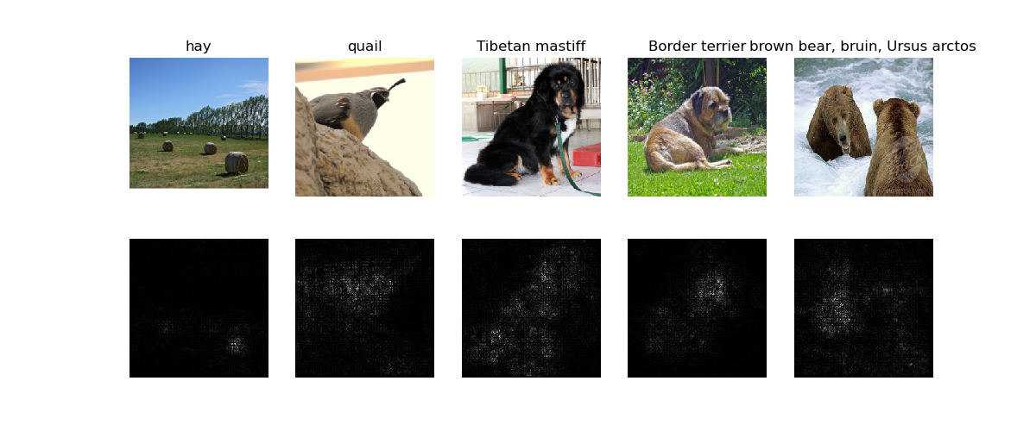
Saliency Map
Include your saliency map here

Slide 4
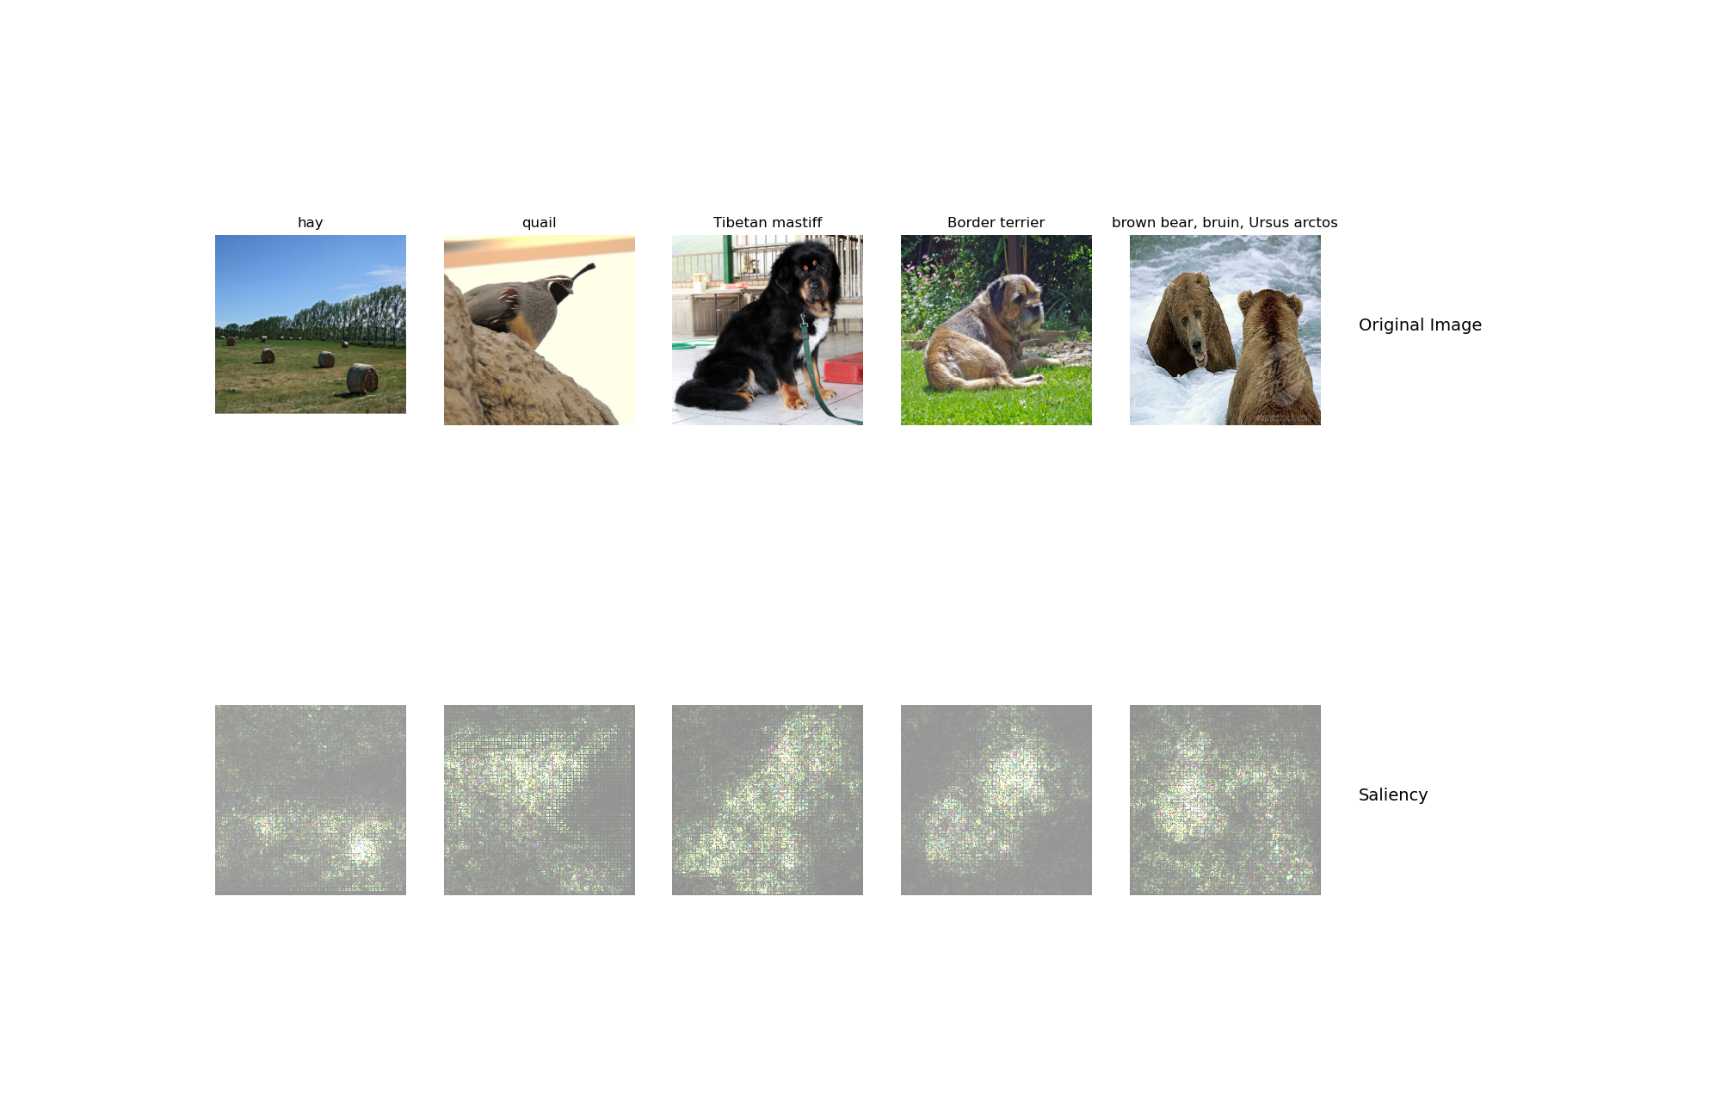
Saliency Map
Include your saliency map from Captum here

Slide 5
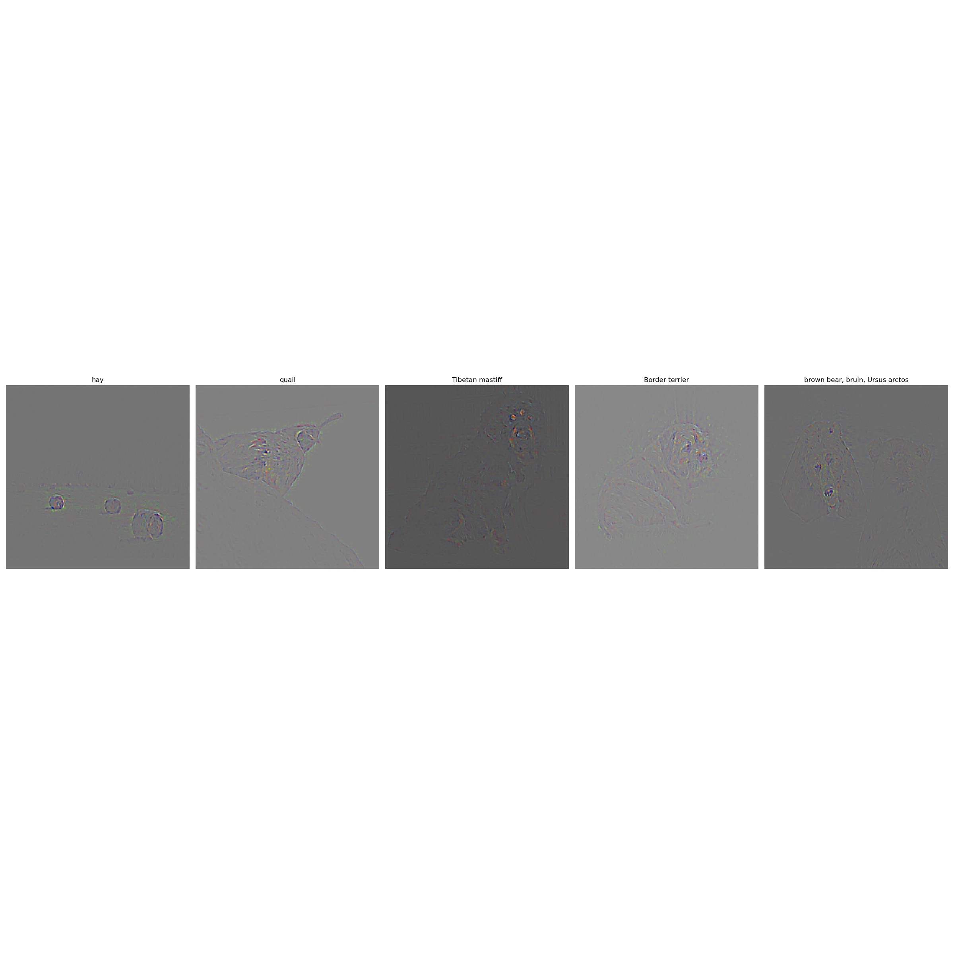
GradCam
Include your visualization of Guided Backprop here

Slide 6
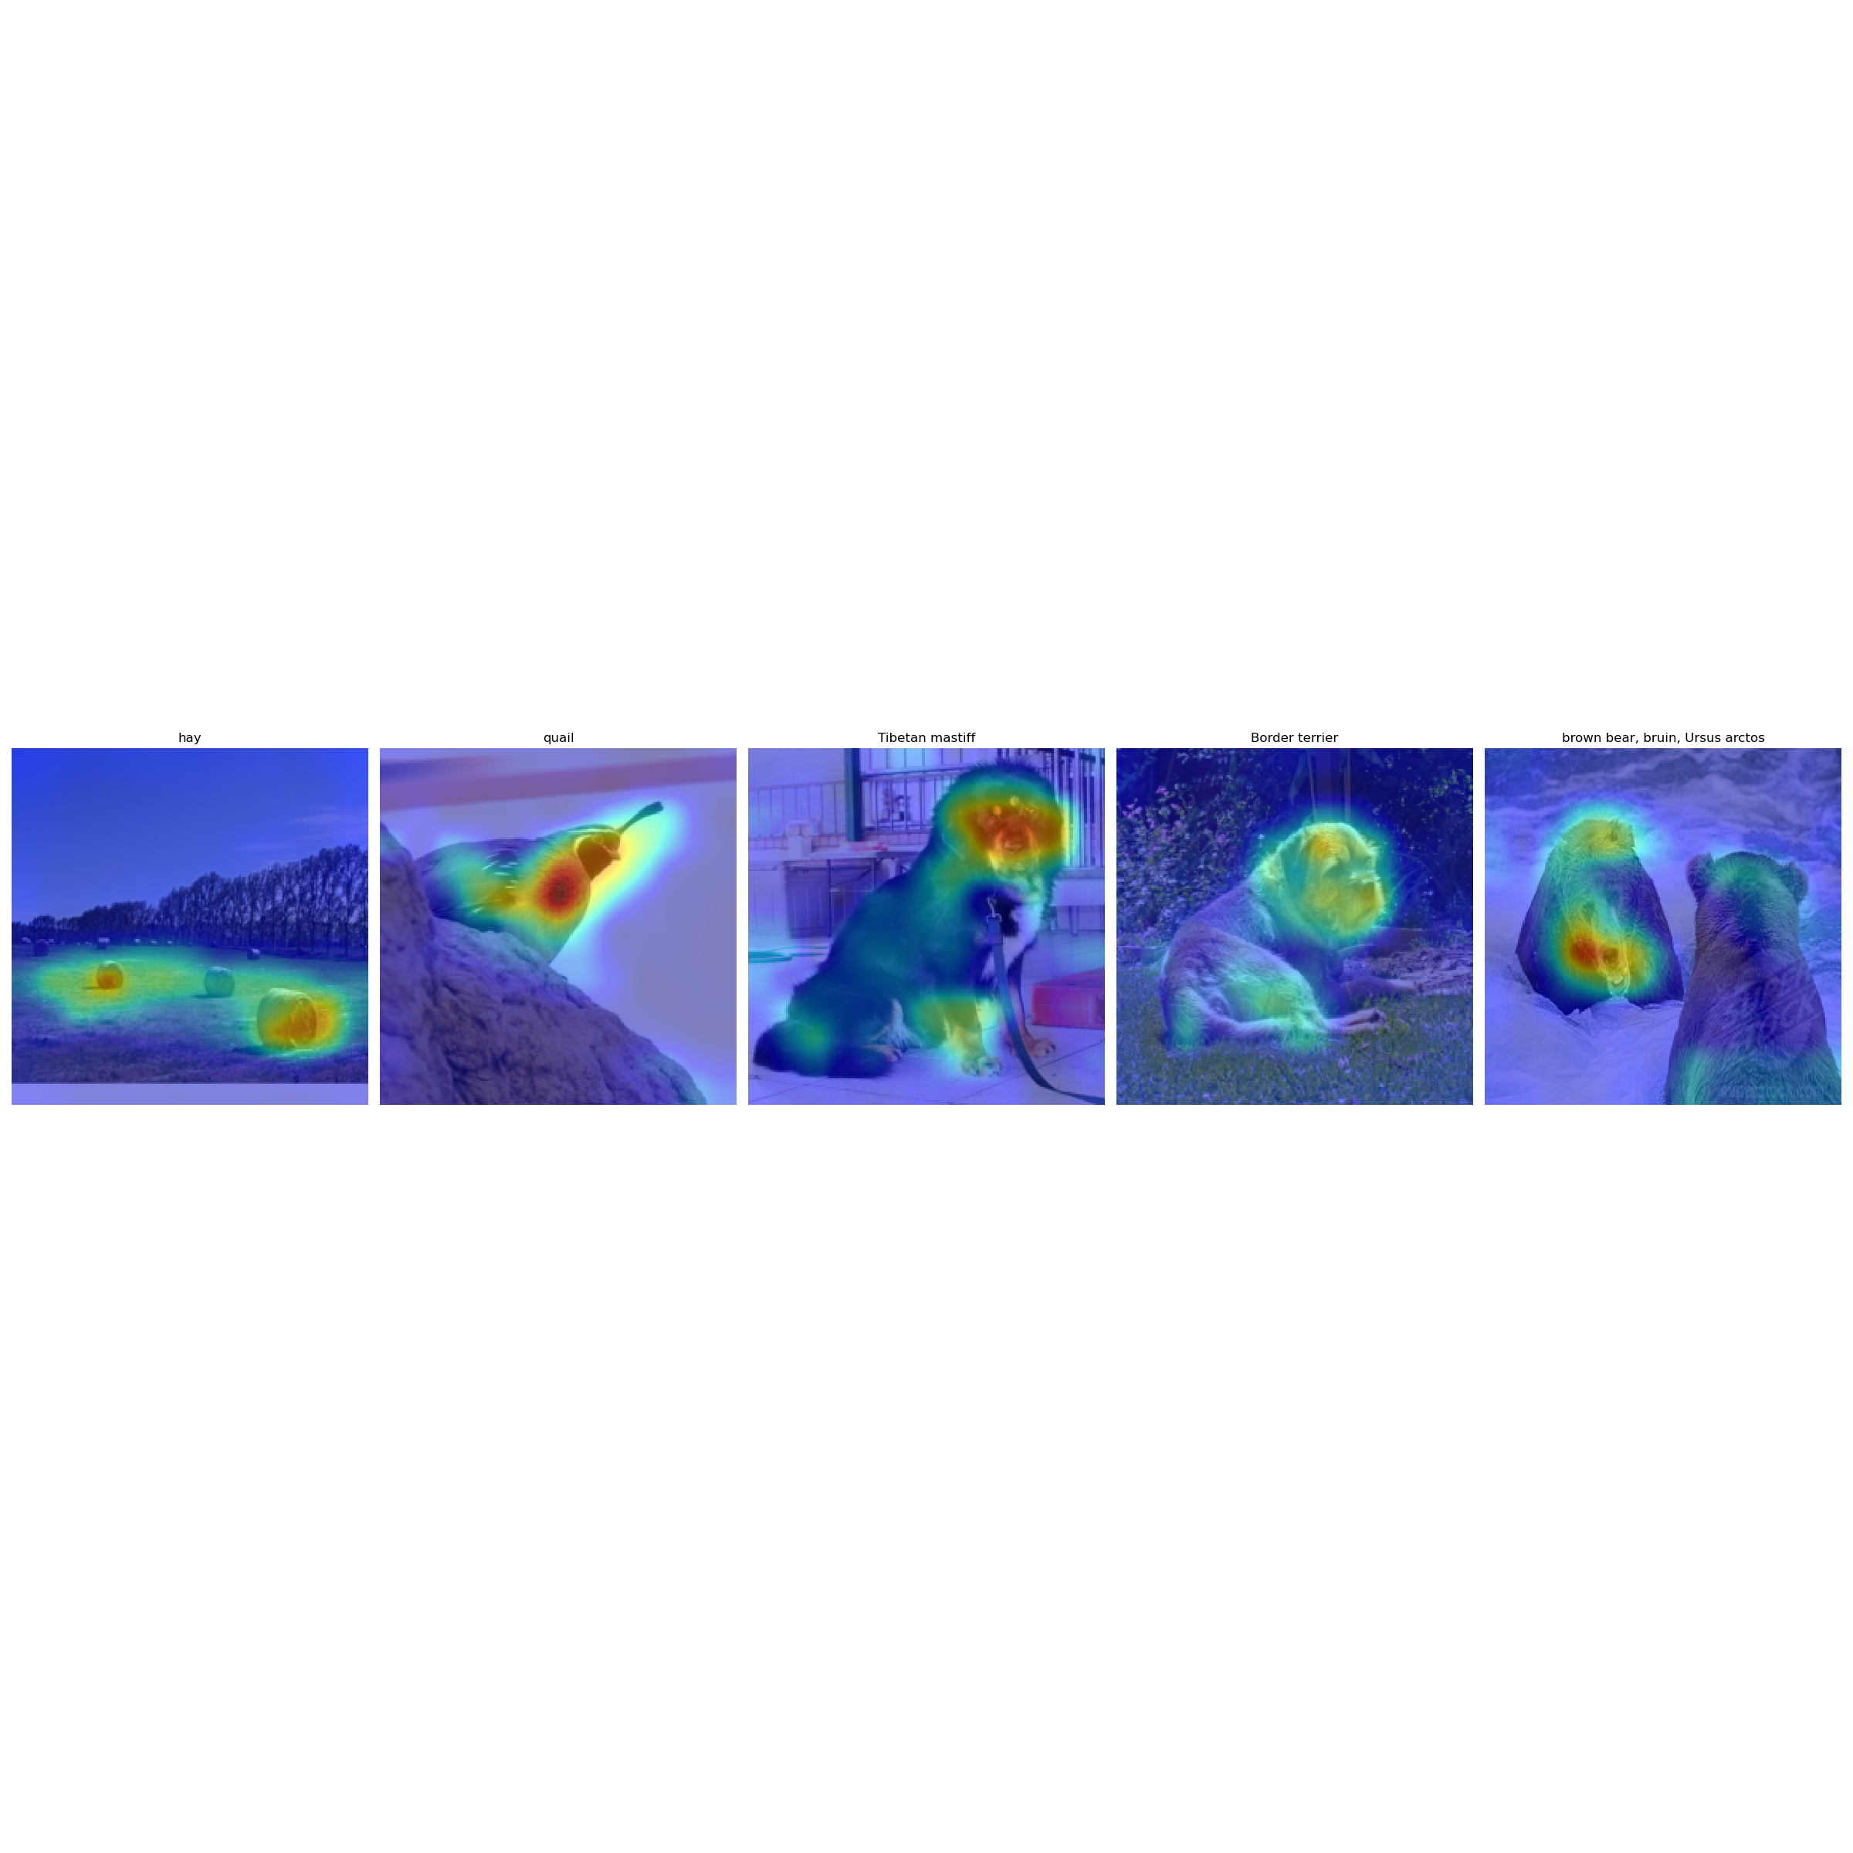
GradCam
Include your visualization of GradCam here

Slide 7
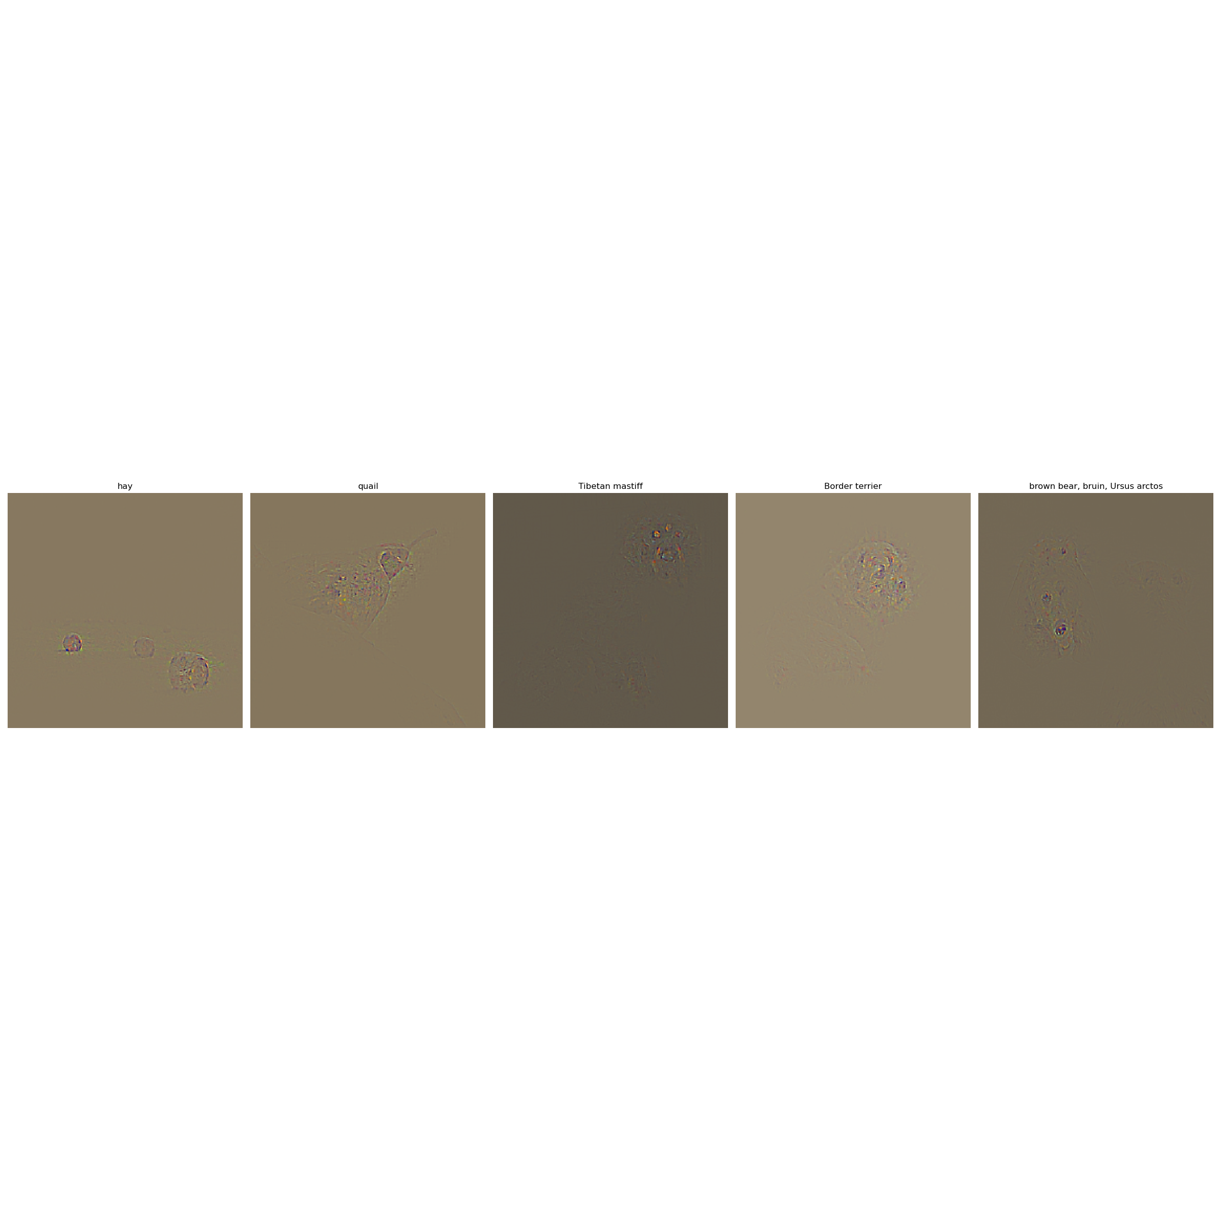
GradCam
Include your visualization of Guided GradCam here

Slide 8
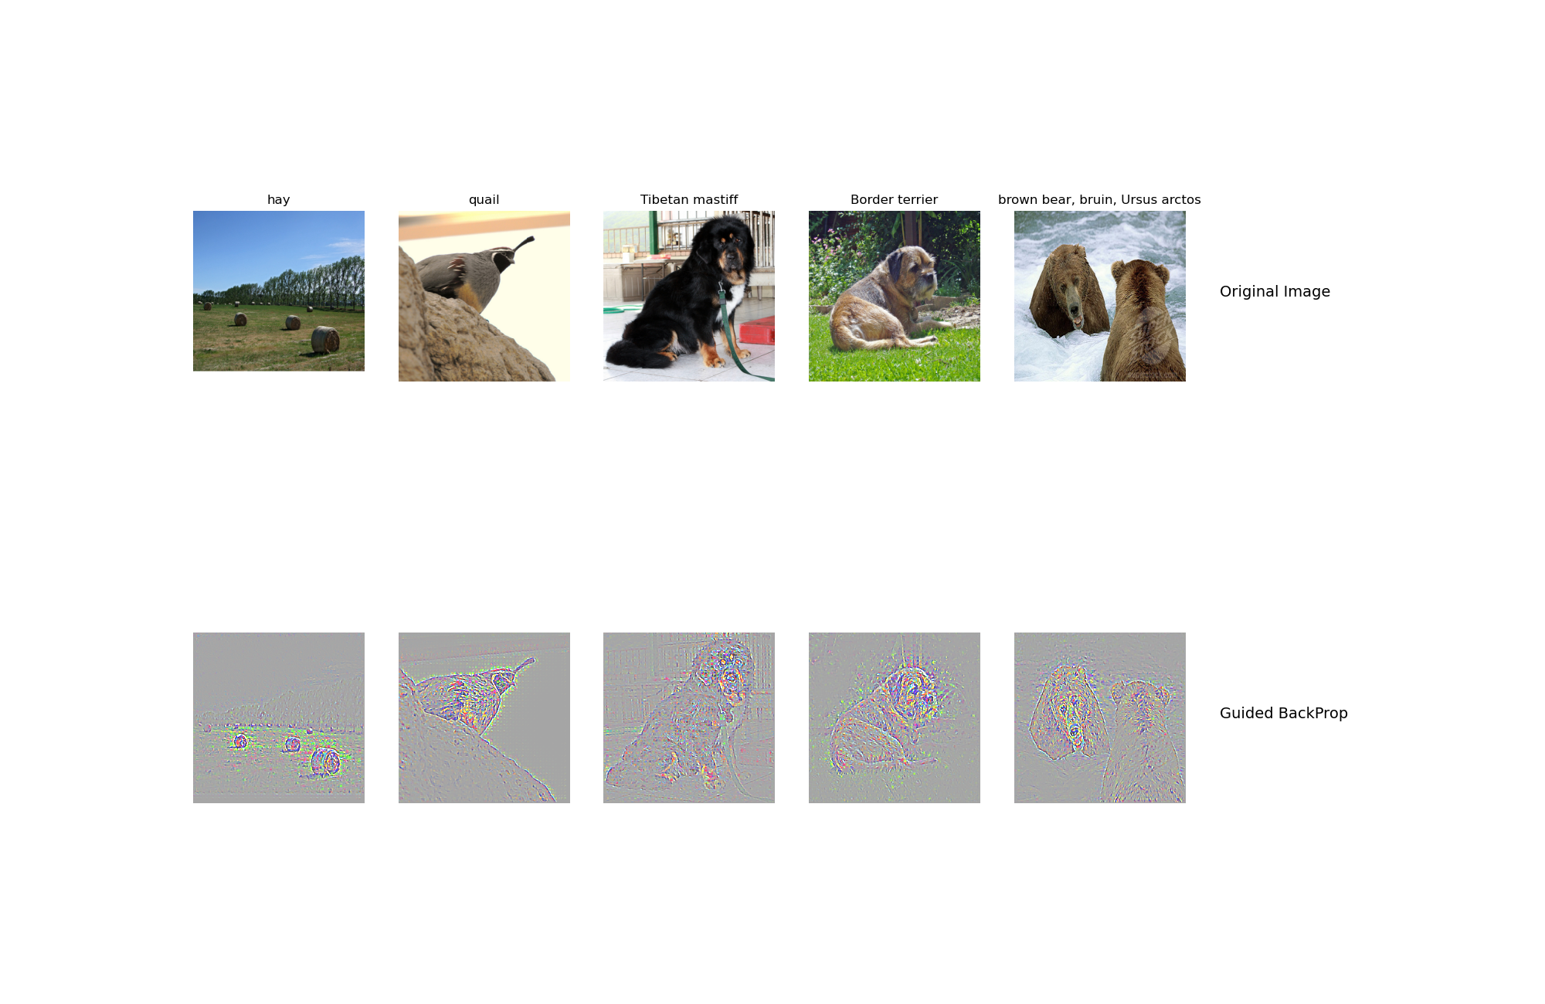

GradCam
Include your visualization of Guided Backprop and Guided Gradcam from Captum here

Slide 9
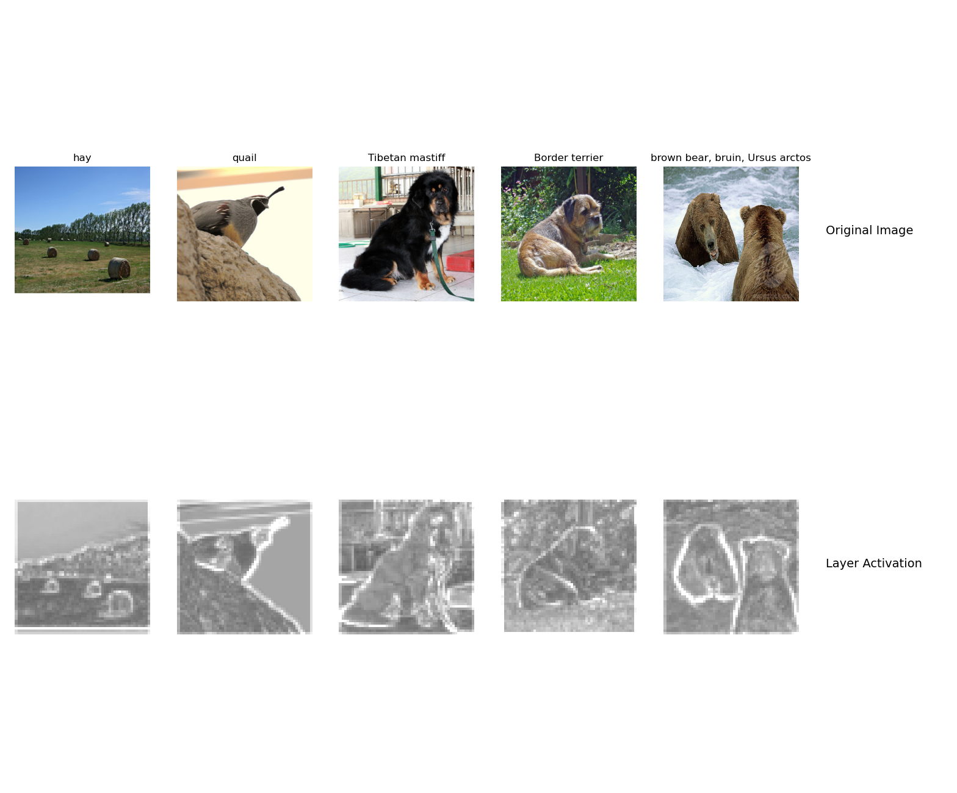
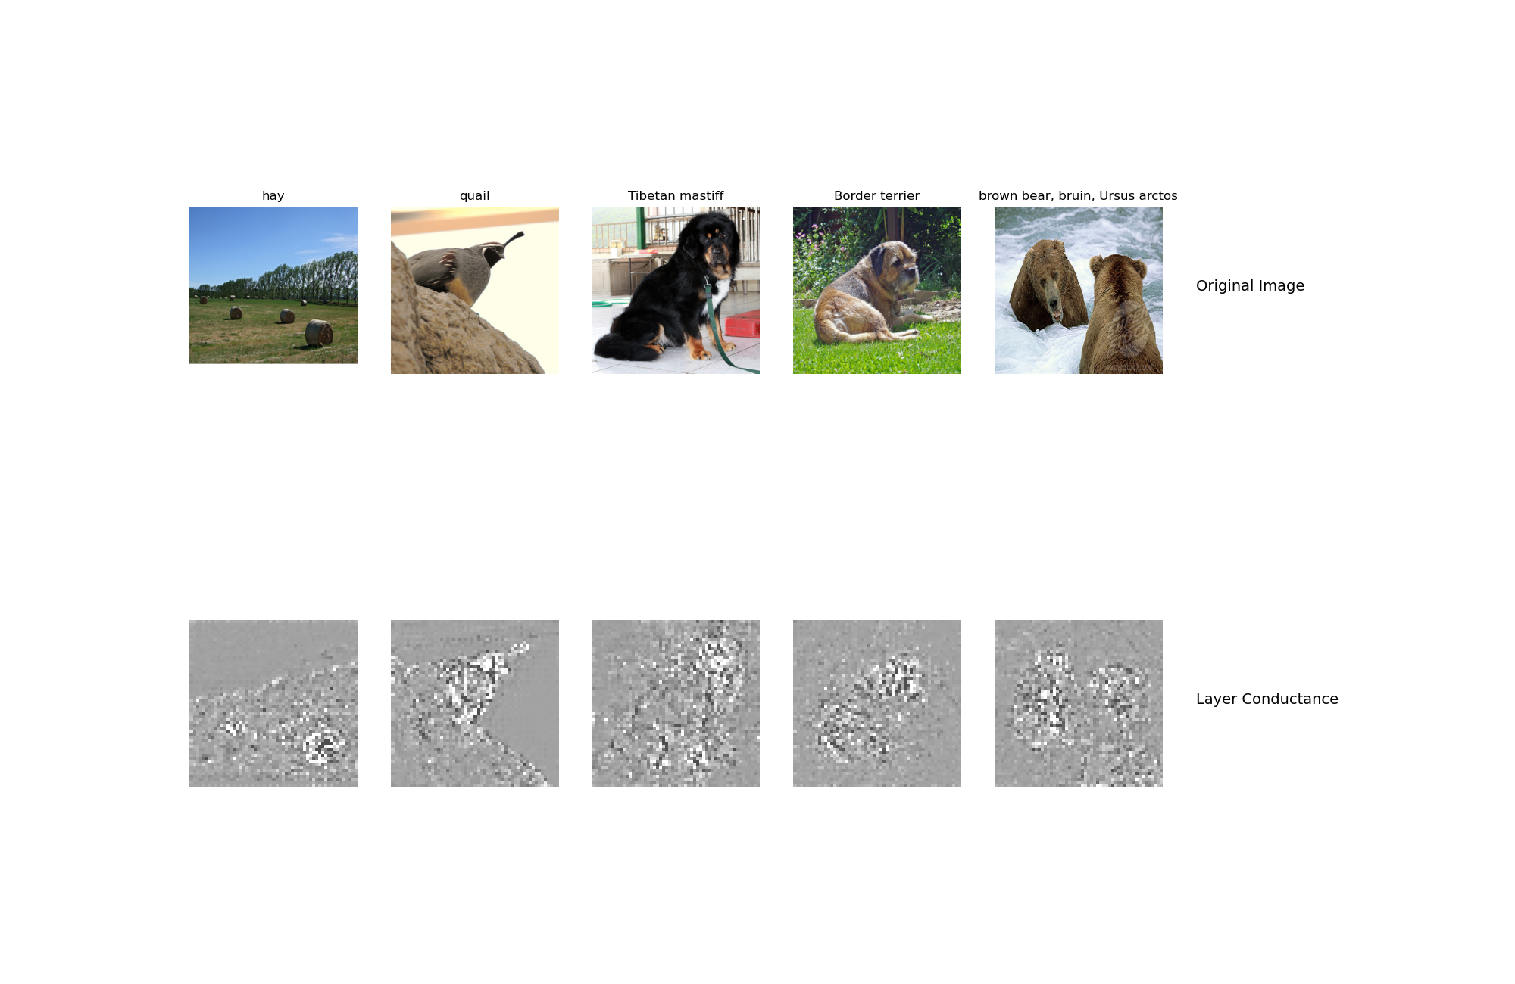
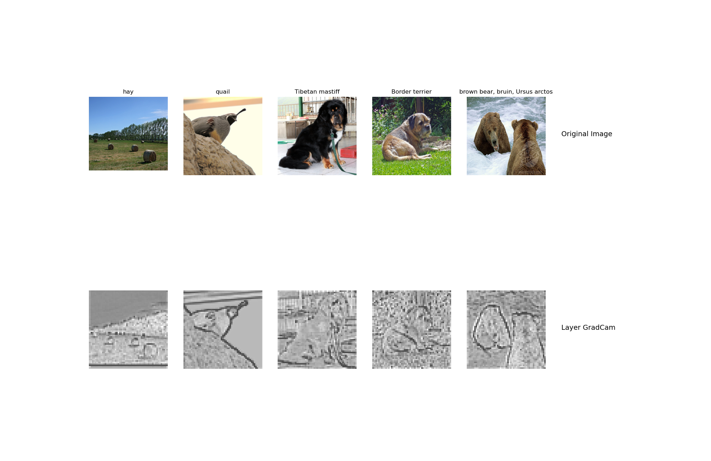
GradCam
Visualization of layers and neurons using Captum here:

Slide 10
What do saliency map and Gradcam tell you
Answer: They both tell us which parts of the image contribute to which degree to particular layers, or to the overall classification outcome. They tell us the relative importance of different pixels for specific classification tasks. Viewed another way, they tell us the degree to which different pixels elicit activation of various filters or even neurons. In many of the example images, the greatest activations seem to occur around animal faces (and, I suppose, the ‘faces’ of the hay). I don’t know whether this implies a sensitivity in the model to faces in general or just to collections of edges and motifs that are more prevalent in these areas, but activations do seem denser here.

Slide 11
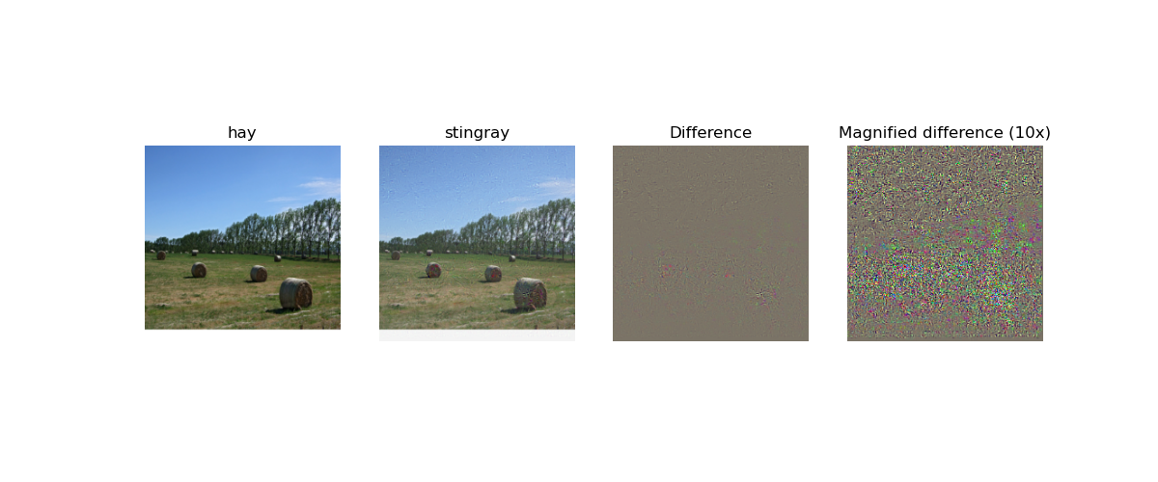
Fooling Image
Include the fooling image here

Slide 12
Fooling Image
What insights do you get from fooling images:
Answer: Relatively minor noise from a human visual perspective can fool models, underscoring the idea that you don’t need to have a substantially (from a human visual standpoint) different image in terms of edges, motifs, or other higher level features in order to change the classification outcome. This also underscores how CNN’s classify differently than humans do and may particularly highlight a texture bias. The location of the noise in the hay image indicates that both background and foreground changes contributed to the fooling, but most of the noise seems to have been applied to the hay itself, possibly implying that changes to local features there were key.

Slide 13
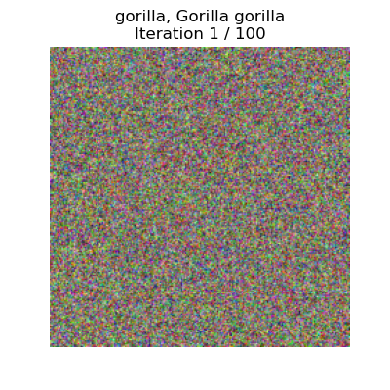
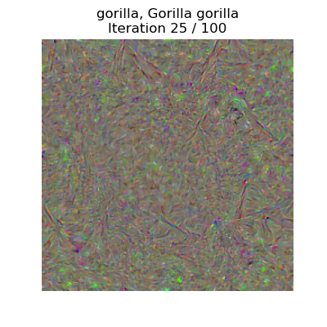
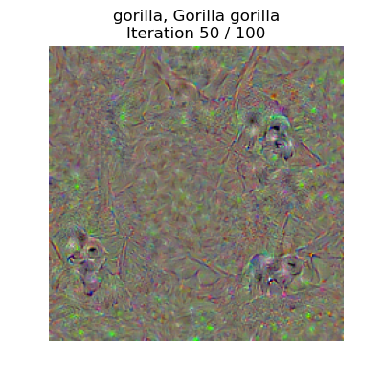
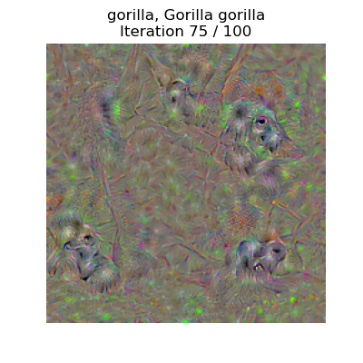
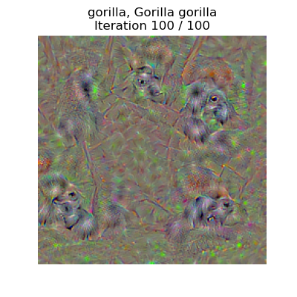
Class Visualization

Slide 14
Style Transfer

Slide 15
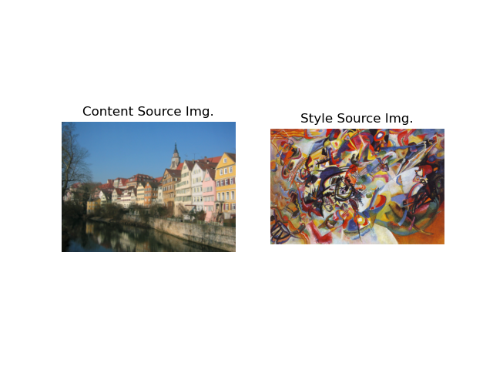
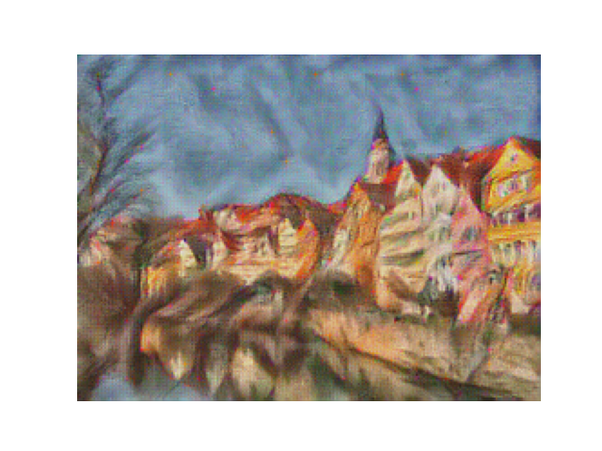
Composition VII + Tubingen
Include both original images and the transferred image

Slide 16
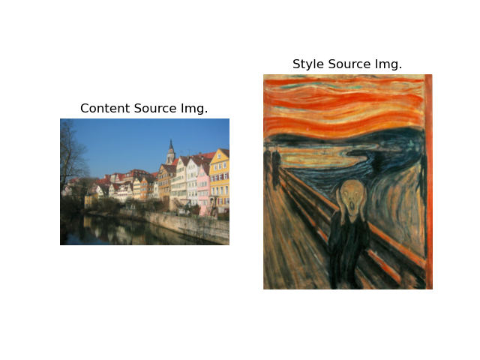
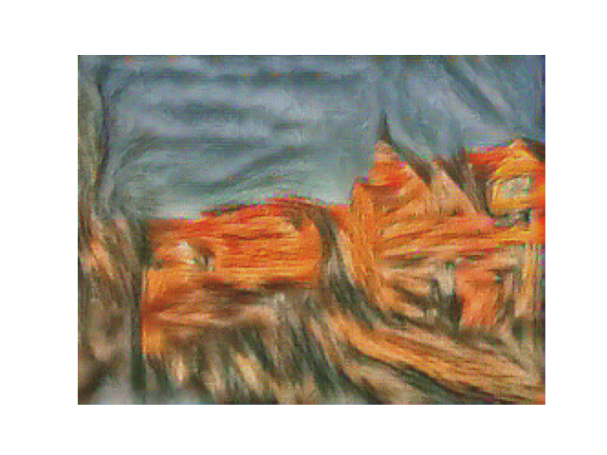
Scream + Tubingen
Include both original images and the transferred image

Slide 17
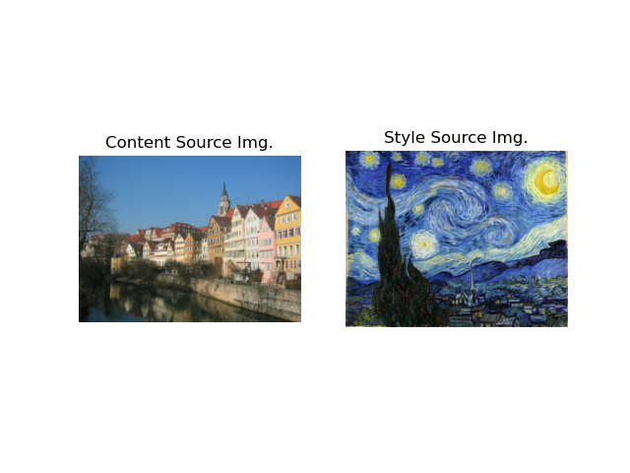
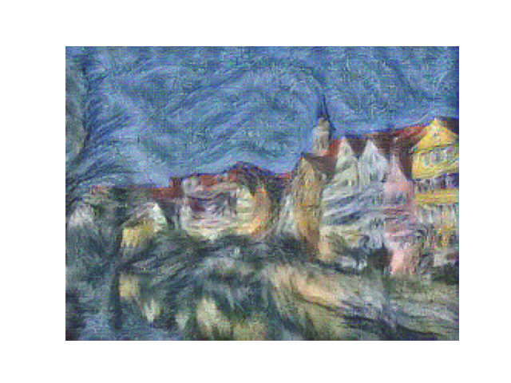
Starry Night + Tubingen
Include both original images and the transferred image

